Slide 1
Chapter 11.04 : Discrete Fourier Transform (DFT)
Lecture # 8
by
Dr. Md. Rajibul Islam
CSE, UAP

Slide 2
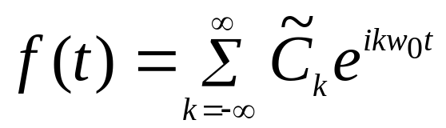
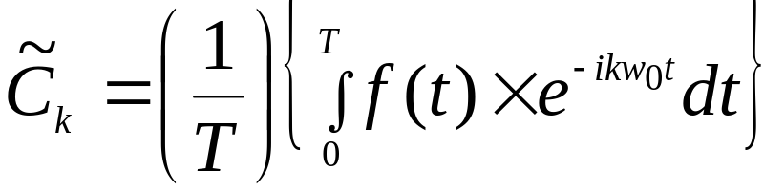
Discrete Fourier Transform
Recalled the exponential form of Fourier series
(see Eqs. 39, 41 in Ch. 11.02), one gets:
(39, repeated)
(41, repeated)

Slide 3

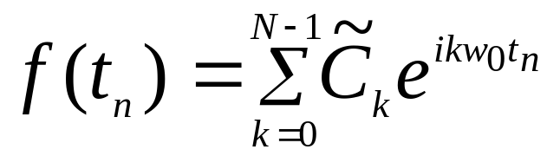
Discrete Fourier Transform
If time “ ” is discretized at
then Eq. (39) becomes:
(1)

Slide 4
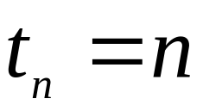
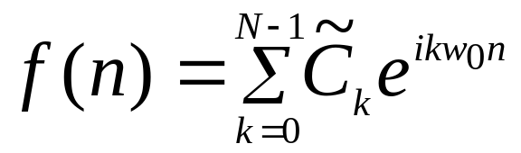
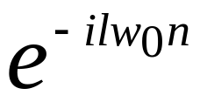

Discrete Fourier Transform cont.
To simplify the notation, define:
(2)
Then, Eq. (1) can be written as:
(3)
Multiplying both sides of Eq. (3) by
, and performing
the summation on “ ”, one
obtains (note: l = integer
number)

Slide 5
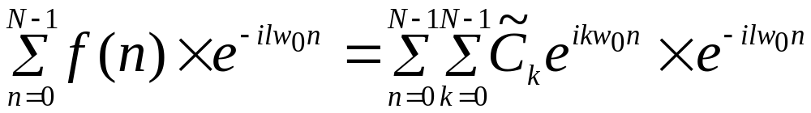
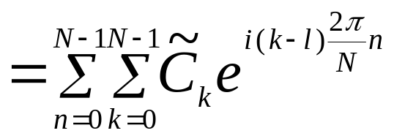
Discrete Fourier Transform cont.
(4)
(5)

Slide 6
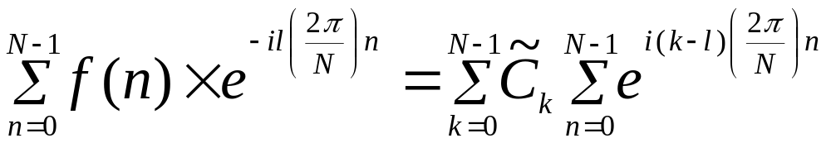
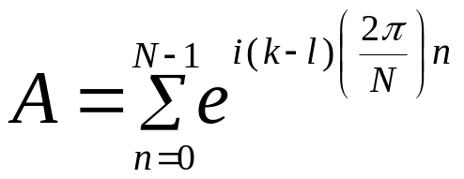
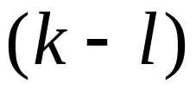
Discrete Fourier Transform cont.
Switching the order of summations on the
right-hand-side of Eq.(5), one obtains:
(6)
Define:
(7)
There are 2 possibilities for to be considered in Eq. (7)

Slide 7
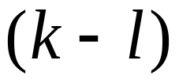
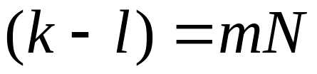


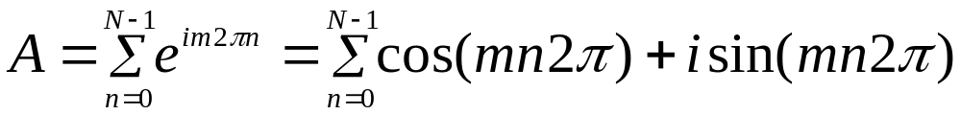

Discrete Fourier Transform—Case 1
Case(1): is a multiple integer of N, such as: ; or where
Thus, Eq. (7) becomes:
(8)
Hence:
(9)

Slide 8
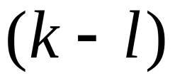

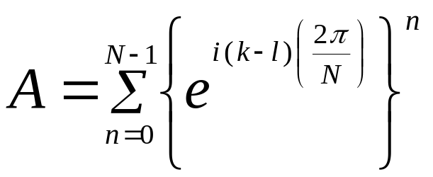
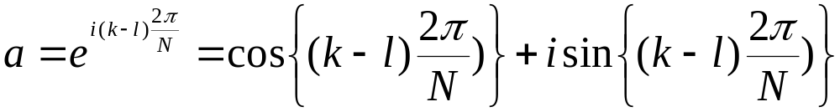
Discrete Fourier Transform—Case 2
Case(2): is NOT a multiple integer of In this case, from Eq. (7) one has:
(10)
Define:
(11)

Slide 9
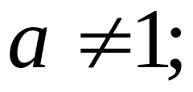
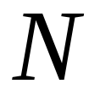
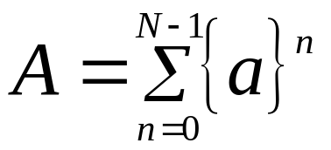
Discrete Fourier Transform—Case 2
because is “NOT” a multiple integer of
Then, Eq. (10) can be expressed as:
(12)

Slide 10
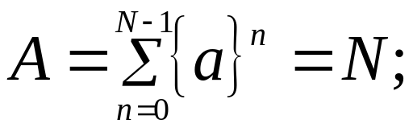

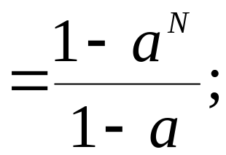

Discrete Fourier Transform—Case 2
From mathematical handbooks, the right side of
Eq. (12) represents the “geometric series”, and can
be expressed as:
if
(13)
if
(14)

Slide 11

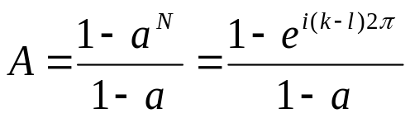
Discrete Fourier Transform—Case 2
Because of Eq. (11), hence Eq. (14) should be used
to compute . Thus:
(See Eq. (10))
(15)
(16)

Slide 12


Discrete Fourier Transform—Case 2
Substituting Eq. (16) into Eq. (15), one gets
(17)
Thus, combining the results of case 1 and case 2, we get
(18)

Slide 13
THE END

Slide 14
Acknowledgement
This instructional power point brought to you by
Numerical Methods for STEM undergraduate
http://numericalmethods.eng.usf.edu
Committed to bringing numerical methods to the undergraduate

Slide 15
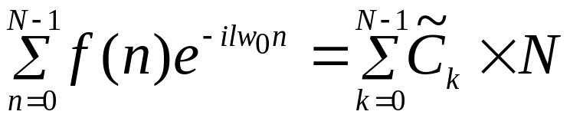

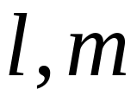

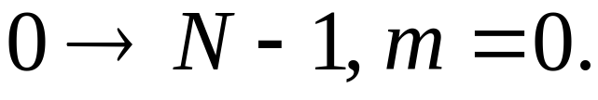


Lecture # 9
Chapter 11.04: Discrete Fourier Transform (DFT)
Substituting Eq.(18) into Eq.(7), and then referring
to Eq.(6), one gets:
(18A)
Recall (where are integer numbers),
And since must be in the range
Thus:
becomes

Slide 16
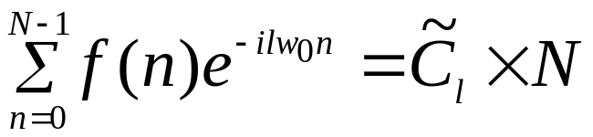
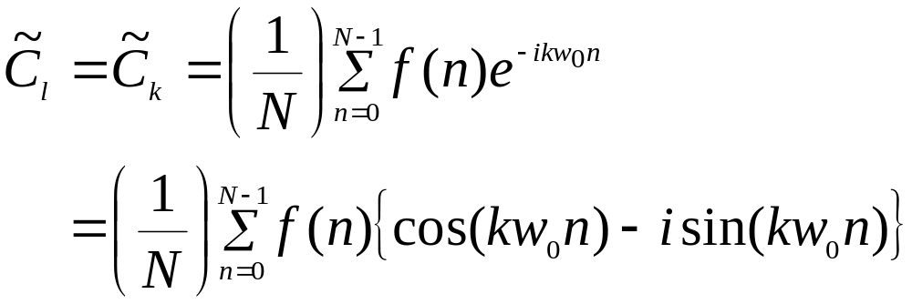
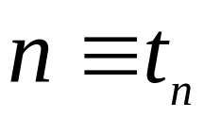
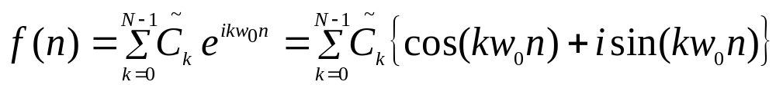
Discrete Fourier Transform—Case 2
Eq. (18A) can, therefore, be simplified to
(18B)
Thus:
(19)
where
and
(1, repeated)

Slide 17
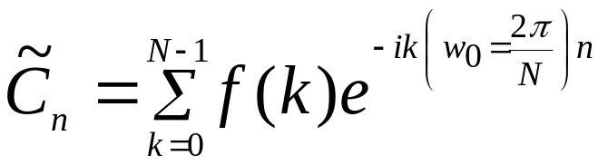
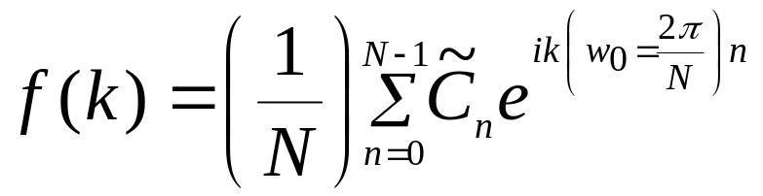
Discrete Fourier Transform cont.
Equations (19) and (1) can be rewritten as
(20)
(21)

Slide 18
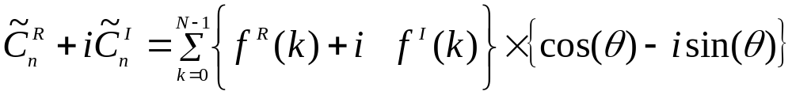
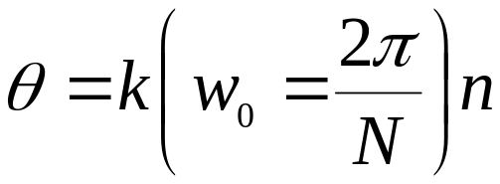
Discrete Fourier Transform cont.
To avoid computation with “complex numbers”,
Equation (20) can be expressed as
(20A)
where

Slide 19
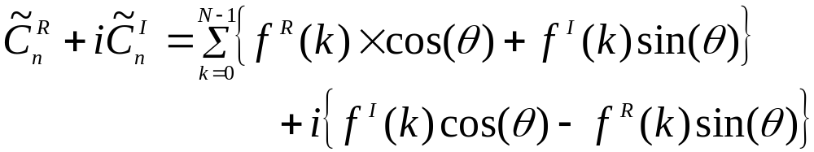
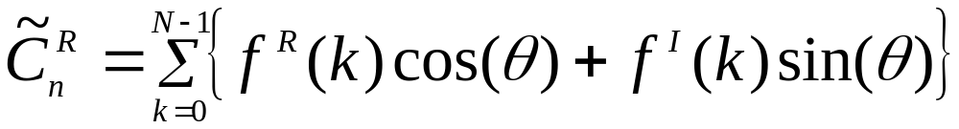
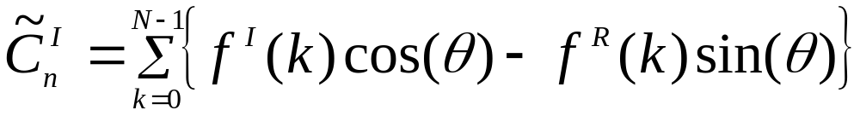
Discrete Fourier Transform cont.
(20B)
The above “complex number” equation is equivalent to
the following 2 “real number” equations:
(20C)
(20D)

Slide 20
THE END

Slide 21
Acknowledgement
This instructional power point brought to you by
Numerical Methods for STEM undergraduate
http://numericalmethods.eng.usf.edu
Committed to bringing numerical methods to the undergraduate

Slide 22
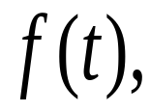
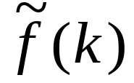

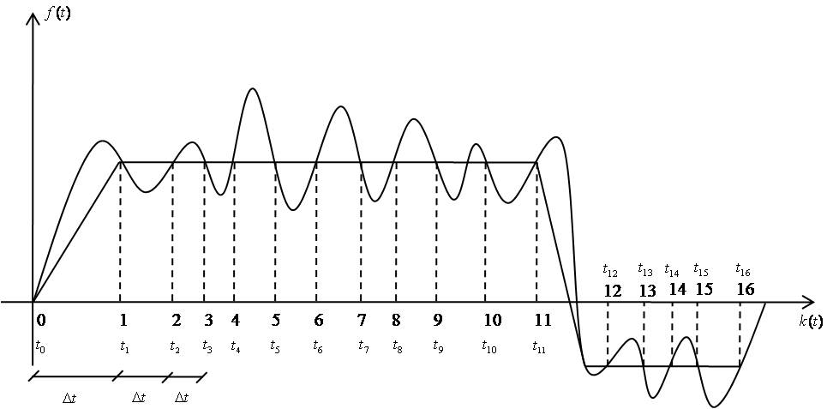
Chapter 11.04: Aliasing Phenomenon, Nyquist samples, Nyquist rate (Contd.)
Lecture # 10
When a function
which may represent the signals
from some real-life phenomenon (shown in Figure 1), is sampled, it basically converts that function into a sequence
at discrete locations of
Figure 1: Function to be sampled and “Aliased” sample problem.

Slide 23

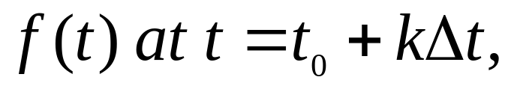

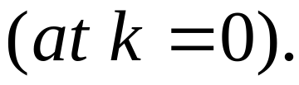
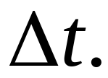
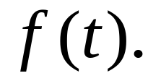
Aliasing Phenomenon, Nyquist samples, Nyquist rate cont.
Thus,
represents the value of
where
is the location of the first sample
In Figure 1, the samples have been taken with a fairly large Thus, these sequence of discrete data will not be able to recover the original signal function

Slide 24
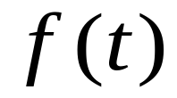

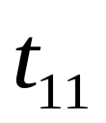

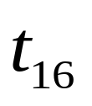

Aliasing Phenomenon, Nyquist samples, Nyquist rate cont.
For example, if all discrete values of were connected by piecewise linear fashion, then a nearly horizontal straight line will occur between through
and through respectively (See Figure 1).
These piecewise linear interpolation (or other interpolation
schemes) will NOT produce a curve which closely
resembles the original function . This is the case
where the data has been “ALIASED”.

Slide 25
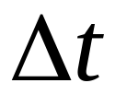



“Windowing” phenomenon
Another potential difficulty in sampling the function is called “windowing” problem. As indicated in Figure 2,
while is small enough so that a piecewise linear interpolation for connecting these discrete values will adequately resemble the original function , however, only a portion of the function has been sampled (from through ) rather than the entire one. In other words, one has placed a “window” over the function.

Slide 26
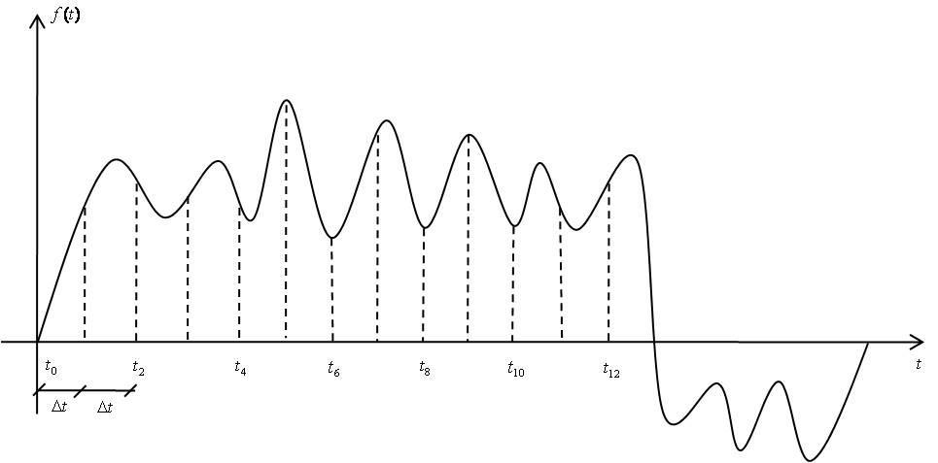
“Windowing” phenomenon cont.
Figure 2. Function to be sampled and “windowing” sample problem.

Slide 27
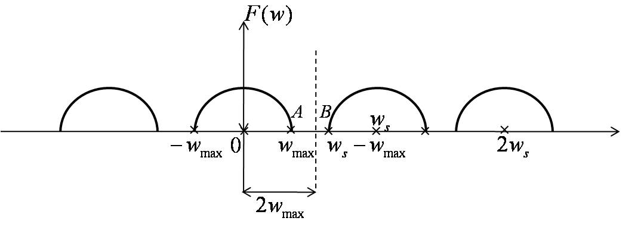




“Nyquist samples, Nyquist rate”
Figure 3. Frequency of sampling rate versus maximum frequency content
In order to satisfy the frequency ( ) should be between points A and B of Figure 3.

Slide 28


“Nyquist samples, Nyquist rate”
Hence:
which implies:
Physically, the above equation states that one must have at least 2 samples per cycle of the highest frequency component present (Nyquist samples, Nyquist rate).

Slide 29

“Nyquist samples, Nyquist rate”
Figure 4. Correctly reconstructed signal.

Slide 30


“Nyquist samples, Nyquist rate”
In Figure 4, a sinusoidal signal is sampled at the rate of 6 samples per 1 cycle (or ). Since this sampling rate does satisfy the sampling theorem requirement of , the reconstructed signal does correctly represent the original signal.

Slide 31



“Nyquist samples, Nyquist rate”
In Figure 5 a sinusoidal signal is sampled at the rate of 6 samples per 4 cycles
Since this sampling rate does NOT satisfy the requirement the reconstructed signal was wrongly represent the original signal!
Figure 5. Wrongly reconstructed signal.

Slide 32
THE END

Slide 33
Acknowledgement
This instructional power point brought to you by
Numerical Methods for STEM undergraduate
http://numericalmethods.eng.usf.edu
Committed to bringing numerical methods to the undergraduate

